Slide 1

Mitigating Customer Churn
Data-Driven Retention Strategies for Modern Telecom Prepared by: Sarah Border
Instructor: Raygene Patterson
Institution: Pivot Tech School

Slide 2
The Business Case
Quantifying the 26.54% revenue leakage
At what point in the customer lifecycle is churn most heavily concentrated?
Which specific products or service types have the highest vulnerability to customer turnover?
What is the correlation between customer satisfaction scores and actual churn behavior?
How do payment types and billing methods impact customer retention?
Notes:
To understand the scale of the problem, we first have to quantify our high-level baseline metrics. Churn isn't just a customer service metric; it directly impacts our top-line revenue and increases our marketing acquisition costs.

Slide 3
Overview
Dataset: Telco customer churn (11.1.3+)
Source: Kaggle (Author - Al Fath Terry)
Number of Records: 7,043
Time Period: Unspecified date
Limitations: The data set had multiple years of data available, but the exact years were not included.

Slide 4
Data Preparation
Missing Values: I found that the people who did not have internet services had no value, so I left that off the chart in the internet services chart it did not impact the question at hand.
Calculated Fields: Total Revenue, Churn Rate, and Churned Customers

Slide 5
Executive Summary
26.54%
1,869
Churn Rate
Total Lost Customers
The current churn rate represents a significant operational risk, with nearly one-quarter of the customer base opting out. Identifying the "When, What, Why, and How" is critical for survival.

Slide 6
End-to-End Analysis Workflow
SQL Extraction
Python Analysis
Power BI Visuals
Strategic Action
Aggregating churn thresholds from raw database tables.
Statistical validation using Seaborn and Pandas.
Dynamic dashboards for executive drill-down.
Deployment of targeted retention campaigns.
Notes:
What I used…SQL,Python,PowerBI,
Now that we know the scale of the problem and the tools used to solve it, let’s jump into the diagnostic pillars to answer our very first major business question: When exactly are these customers leaving us?

Slide 7
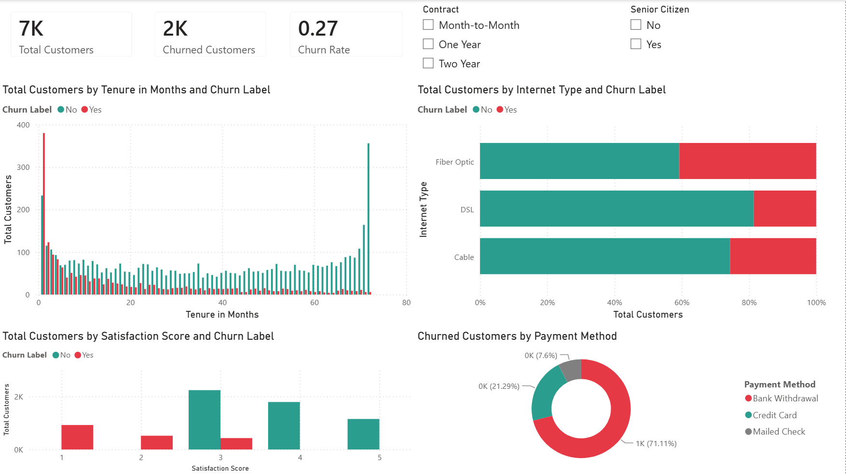
Notes:
switch to power bi to show the dashboard live action

Slide 8
The "When" & "What"
Analyzing Tenure and Product Vulnerability

Slide 9
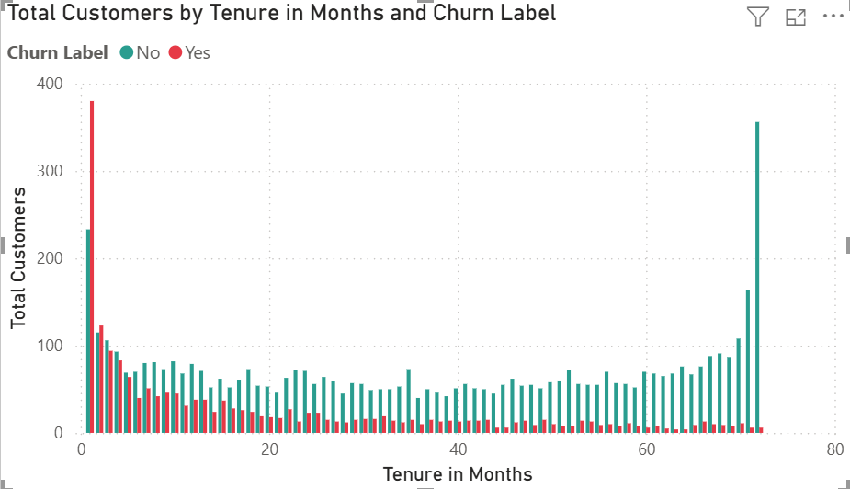
The First-Year Loyalty Cliff (When?)
Data validation confirms that customers are most vulnerable during their first 12 months. Surmounting the "First-Year Cliff" increases lifetime value by 3.5x.

Slide 10
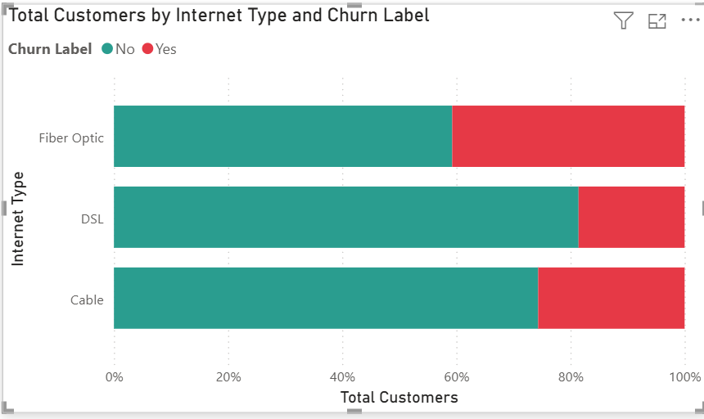

Product Vulnerability Analysis (What?)
Fiber Optic customers exhibit a 45% churn rate, indicating significant issues with either installation reliability, pricing expectations, or service technicalities compared to DSL and cable.

Slide 11
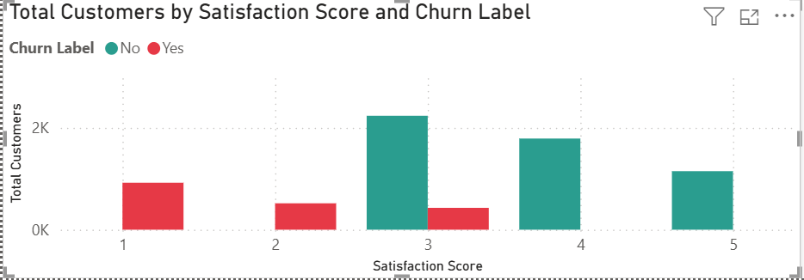
Sentiment Red Zones (Why?)
Any customer recording a Satisfaction Score of 1 or 2 represents an immediate, high-probability churn event.

Slide 12
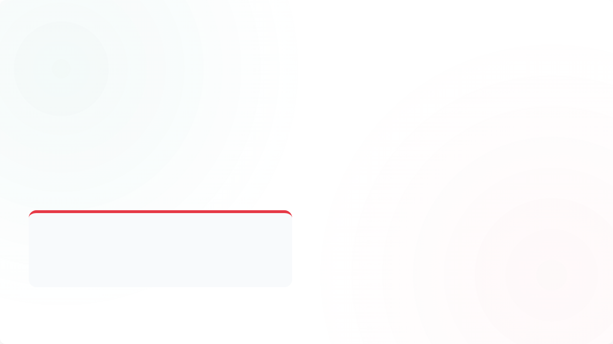
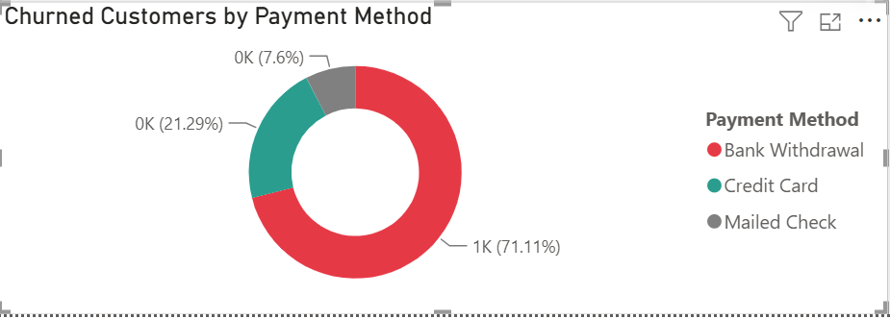
The Billing Leak (How?)
Manual Bank Withdrawal Risk
Our analysis identifies manual Bank Withdrawal as a primary operational churn trigger. Unlike automated billing, manual touchpoints provide monthly "re-evaluation" opportunities that lead to attrition.

Slide 13
Strategic Action Items
Target First-Year Retention: Deploy high-touch onboarding for the first 12 months to bridge the loyalty gap.
Audit Fiber Optic Service: Investigate technical outages and pricing satisfaction specifically for Fiber Optic cohorts.
Incentivize Auto-Pay: Move customers away from Bank Withdrawal toward Credit Card/Auto-pay with small monthly discounts.
Sentiment Monitoring: Implement real-time alerts for any satisfaction score dropping below 3.
Notes:
next steps

Slide 14

Operational Excellence
By shifting from a reactive "churn-fix" mindset to a proactive, data-driven lifecycle management strategy, Telecom can reclaim up to 40% of the lost revenue.
The path forward requires a unified approach across product, finance, and customer service.
Notes:
conclusion Summarize findings.
Discuss limitations.
Identify future opportunities for analysis.

Slide 15
Questions?
Thank you for your time.
Sarah Border | Data Analyst Student
linkedin.com/in/sarah-border-150a412a1
Notes:
Thank you and questions

Slide 16

Informational Resources
Al Fath Terry. “Telco Customer Churn (11.1.3+).” 2024, Accessed 2026. https://www.kaggle.com/datasets/alfathterry/telco-customer-churn-11-1-3
https://image.slidesdocs.com/responsive-images/background/conceptual-design-featuring-a-3d-finance-consultant-and-data-analyst-with-a-blue-render-powerpoint-background_e2813128f9__960_540.jpg
Source: slidesdocs.com

